Slide 1
Lecture 19-22: Active and passive sensing - IoT and AI

Slide 2
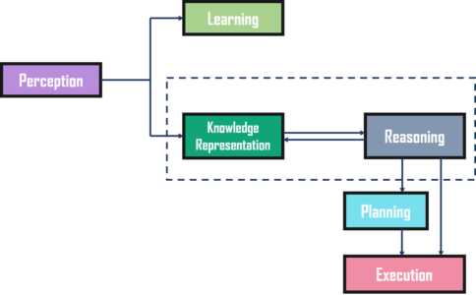
Intelligent Systems
IS are systems that have the ability to learn, reason, and perceive the environment to make decisions and perform actions.
Sensing is the ability of a system to gather information from the environment through sensors and other devices.
Sensing is an essential component of Intelligent Systems as it provides the necessary data for the system to learn, reason, and make decisions.

Slide 3
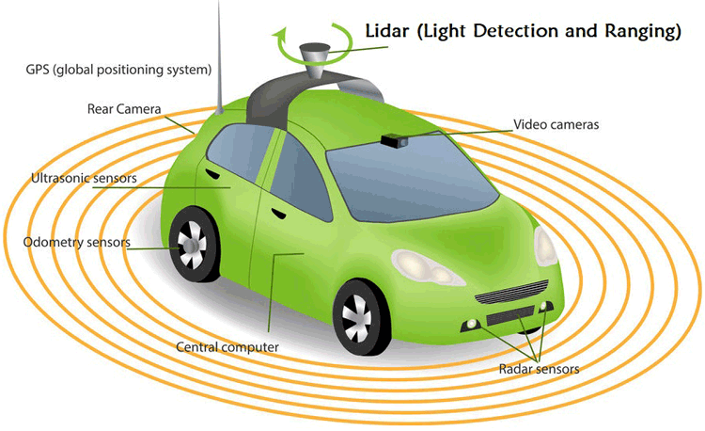
Sensors
Definition: devices that measure physical or environmental conditions and convert them into electrical signals
Examples: cameras, microphones, infrared sensors, tactile sensors
Function: provide feedback to the robot's control system for decision making and movement adjustments
Active Sensors: sensors that emit energy into the environment and measure the response
Examples: radar, sonar, lidar
Passive Sensors: sensors that detect the energy emitted or reflected by objects in the environment without actively emitting energy
Examples: cameras, infrared sensors, acoustic sensors

Slide 4
Passive Sensing
Passive sensing refers to the process of collecting data from the environment without actively emitting any energy or signals.
It involves the detection of naturally occurring signals, such as light, sound, and heat.
Examples:
Temperature Sensors: Detect changes in temperature and are used in a variety of applications such as HVAC systems, food processing, and medical devices.
Light Sensors: Detect the intensity of light and are used in cameras, security systems, and automatic lighting systems.
Acoustic Sensors: Detect sound waves and are used in microphones, sonar systems, and acoustic imaging systems.
Pressure Sensors: Detect changes in pressure and are used in medical devices, automotive systems, and industrial machinery.

Slide 5
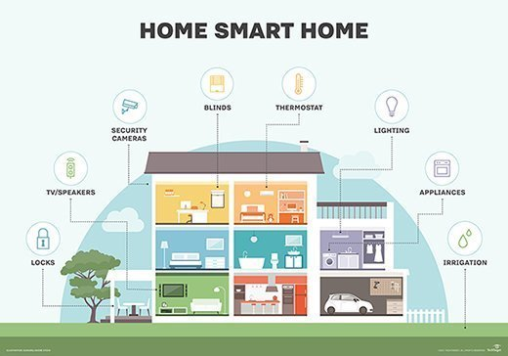
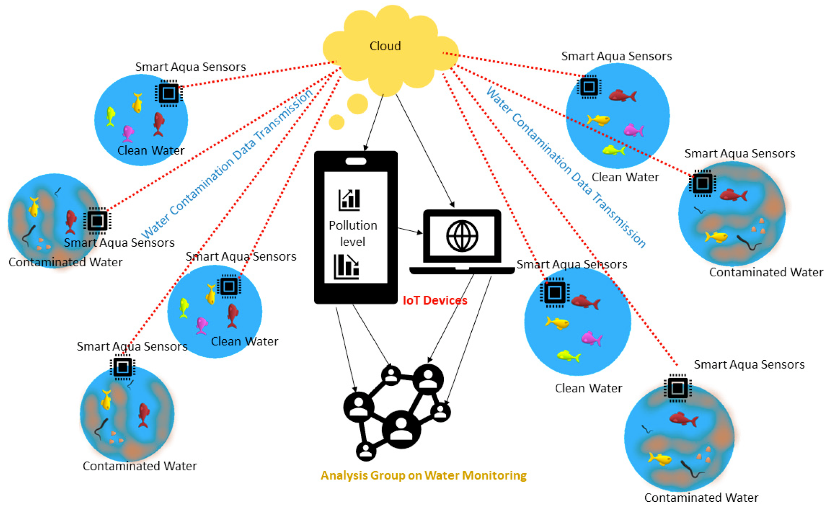
Examples of Passive Sensing
Smart Home: Passive sensors are used in smart home systems to detect temperature changes, motion, and light intensity to automate lighting and temperature control.
Environmental Monitoring: Passive sensors are used in air quality monitoring systems to detect changes in temperature, humidity, and air pressure.
Security Systems: Passive sensors are used in security systems to detect motion, light, and sound to alert homeowners or building managers of potential threats.

Slide 6
Advantages/Limitations: Passive Sensing
Low Power Consumption: Passive sensors do not require a lot of power to operate, making them ideal for use in battery-operated devices.
Non-Invasive: Passive sensors do not emit any signals or energy, making them non-invasive and safe for use in medical devices and other sensitive applications.
Low Cost: Passive sensors are often less expensive than active sensors because they do not require complex circuitry or power sources
Wider area coverage
Less Control: Source of the signal is out of control.
Anomalous sensor identification is difficult.
Limited Range: Passive sensors typically have a limited range and can only detect signals within a certain distance.
Limited Sensitivity: Passive sensors may not be sensitive enough to detect low-level signals or changes in the environment.

Slide 7
Active Sensing
Active Sensing refers to the process of emitting energy into the environment and detecting the response to that energy using sensors.
It involves the use of a source of energy to stimulate the environment and capture the response through sensors.
Examples:
Ultrasonic sensors: emit high-frequency sound waves and then detect the echoes to determine distance, presence, and movement of objects.
LiDAR sensors: emit laser beams and measure the time it takes for the reflected beam to return, used for 3D mapping, obstacle detection, and navigation.
Radar sensors: emit radio waves and detect the reflected waves to determine the location, speed, and movement of objects.
Infrared sensors: emit infrared radiation and detect the reflected radiation to determine the temperature and presence of objects.

Slide 8
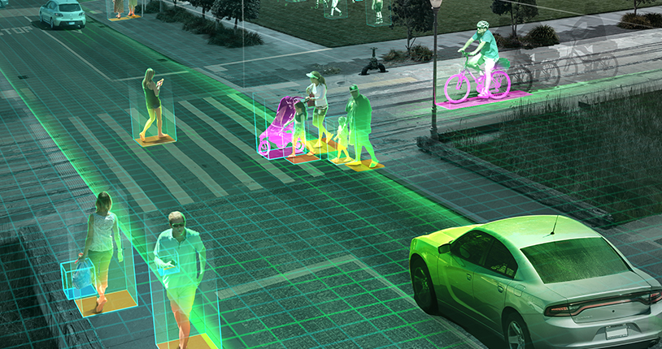
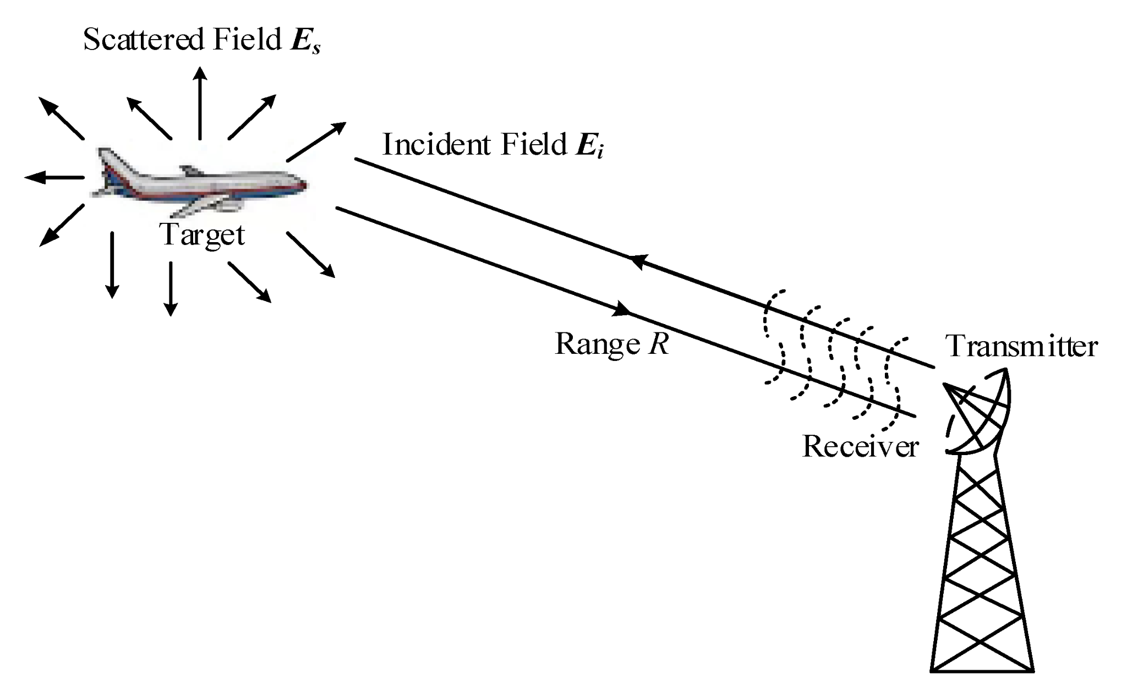
Examples of Active Sensing
LiDAR sensors in self-driving cars to detect obstacles and map the environment.
Ultrasonic sensors in parking assist systems to detect nearby objects and alert drivers.
Radar sensors in aircraft for collision avoidance and weather monitoring.
Sensors in smart homes for motion detection.

Slide 9
Advantages/Limitations: Active Sensing
Can work in low light conditions or complete darkness: This is because active sensors emit their own energy, which can be used to detect objects, regardless of the ambient light conditions.
Can detect objects at a distance: Active sensing techniques can detect objects at a distance, which makes them ideal for applications such as obstacle detection and avoidance in autonomous vehicles and drones.
Can provide high-precision measurements: Useful for applications such as robot localization and mapping etc.
Can be affected by environmental factors such as noise or interference: Environmental factors, such as electromagnetic interference or noise, which can affect the accuracy and reliability of the sensing measurements.
Can consume more power and require more complex hardware: Consumes more power compared to passive sensing techniques. .
Can be more expensive compared to passive sensing techniques: Due to the need for a power source and complex hardware.

Slide 10
Active vs Passive Sensing
Active Sensing | Passive Sensing
Requires a source of energy to emit signals and measure their reflections | Relies on external sources of energy or signals
Uses a dedicated sensor or transmitter | Uses a receiver or detector
Provides more detailed and accurate information | Provides less detailed but more ambient information
Can be more expensive and power-consuming | Can be less expensive and power-efficient
Suitable for noisy or complex sensing environments | Suitable for relatively simple or predictable sensing environments

Slide 11
Active or Passive Sensing?
Active sensing is suitable for situations where the sensing environment is noisy or complex, or when more detailed and accurate information is required, such as:
Radar and sonar systems for navigation and mapping.
Lidar systems for autonomous vehicles and robotics.
Ultrasound systems for medical imaging and diagnostics.
Passive sensing is suitable for situations where the sensing environment is relatively simple or predictable, or when ambient information is sufficient for the task, such as:
Temperature, humidity, and light sensors for smart homes and buildings.
Microphones and cameras for surveillance and security systems.
Magnetic field and vibration sensors for structural health monitoring.
Active and passive sensing can be combined to create a more comprehensive and accurate view of the sensing environment.
To map the 3D structure of an indoor environment and recognize the objects within it.

Slide 12
Quiz

Slide 13

Internet of Things (IoT)

Slide 14
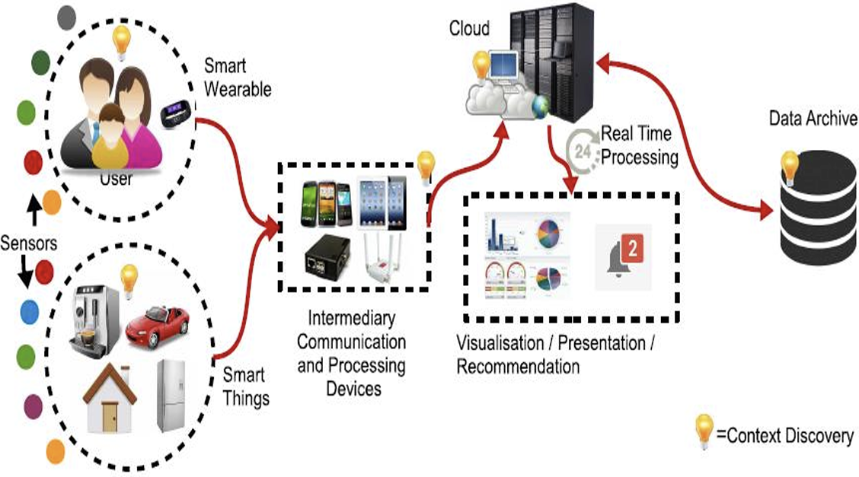
Internet of Things (IoT)
The Internet of Things (IoT) refers to a network of physical objects or "things" that are embedded with electronics, software, sensors, and network connectivity, allowing them to collect and exchange data.
interrelated, internet-connected objects
IoT allows the seamless integration of physical and digital worlds, enabling real-time monitoring, control, and management of a wide range of systems and processes.

Slide 15
Why IoT
Real-time monitoring: IoT enables the real-time monitoring of various systems and processes, allowing businesses to identify issues and respond quickly.
E.g.: A manufacturer can use IoT sensors to monitor the performance of its production line and identify any issues before they become major problems.
Improved efficiency: IoT can help improve the efficiency of various processes by automating tasks and reducing waste.
E.g.: A smart building can use IoT sensors to automatically adjust lighting and temperature based on occupancy, reducing energy consumption.
Cost savings: By enabling real-time monitoring and automation, IoT can help businesses save costs in various areas such as maintenance, energy, and labor.
E.g.: A fleet management company can use IoT sensors to monitor the performance of its vehicles and schedule maintenance only when necessary, reducing maintenance costs.
Improved safety and security: IoT can help improve safety and security by enabling real-time monitoring and alerting.
E.g.: A smart home security system can use IoT sensors to detect intrusions and notify the homeowner immediately.

Slide 16
Characteristics of IoT
Scalability: IoT networks can be easily scaled up or down to accommodate new devices and changing requirements.
Interoperability: IoT devices can communicate and work together seamlessly, regardless of their manufacturer or technology platform.
Data-driven: IoT relies on the collection and analysis of vast amounts of data generated by sensors and other devices to provide insights and inform decision-making.
Security and privacy: IoT networks must be designed to protect the confidentiality, integrity, and availability of data and prevent unauthorized access and use.

Slide 17
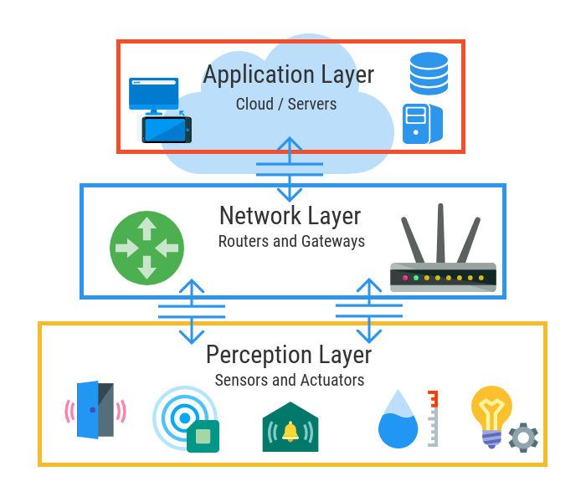
Architecture of IoT
The perception layer: Consists of various sensors and devices that collect data from the environment and transmit it to the network.
The network layer: Responsible for connecting the sensors and devices to the cloud or other centralized system using various communication protocols.
The application layer: This layer includes various software applications that analyze the data and provide insights to end-users.

Slide 18
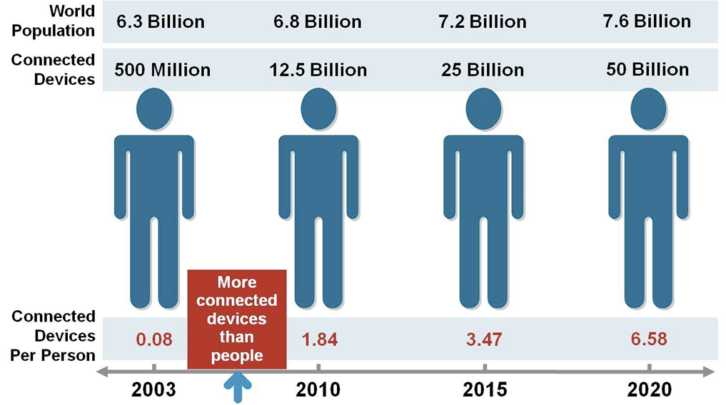
Current Status & Future Prospects of IOT

Slide 19
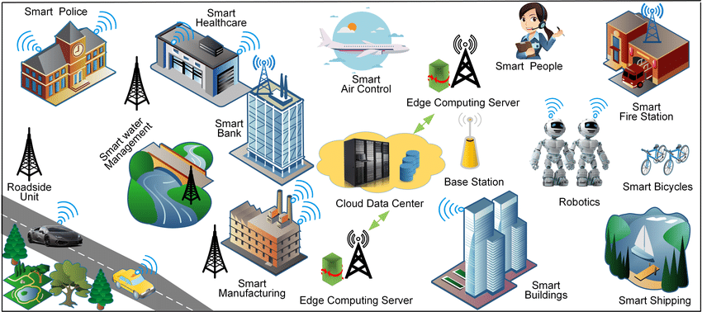
Future Prospects of IOT

Slide 20
Challenges of IoT
Security concerns: With the increasing number of IoT devices and the amount of sensitive data they collect and transmit, security has become a major concern.
Hackers can exploit vulnerabilities in IoT devices to gain access to networks, steal data, or launch attacks.
Interoperability issues: With a wide range of devices from different vendors, it can be challenging to ensure interoperability and compatibility between them.
Privacy concerns: IoT devices collect a lot of personal data, which raises concerns about privacy.
There is a risk that this data could be used for unauthorized purposes or be vulnerable to data breaches.
Energy consumption: IoT devices require power to operate, which can be a challenge for devices that are located in remote areas or are difficult to access.
This can limit the scalability of IoT deployments in certain applications.
Data management: IoT generates vast amounts of data, which can be difficult to manage and analyze
AI for Speed and Accuracy!

Slide 21
Quiz

Slide 22
AI + IOT
“ Without AI-powered analytics, IoT devices and the data they produce throughout the network would have limited value. Similarly, AI systems would struggle to be relevant in business settings without the IoT-generated data pouring in. However, the powerful combination of AI and IoT can transform industries and help them make more intelligent decisions from the explosive growth of data every day. IoT is like the body, and AI the brains, which together can create new value propositions, business models, revenue streams and services.”
- Maciej Kranz, Vice President at Cisco.

Slide 23

AI + IOT Synergy
Data processing and insights: AI algorithms can evaluate this data in real-time to find trends, make predictions, and gain insights.
E.g.: IoT sensors track traffic patterns in smart cities, and AI algorithms improve traffic flow and eliminate congestion.
Automation and efficiency: AI lets IoT devices automate operations using data. In manufacturing,
E.g. : IoT-connected robots may optimize productivity and reduce mistakes by analyzing production line data with AI.

Slide 24
AI + IOT Synergy
Personalization and adaptation: AI IoT systems can tailor user experiences using behavioral data from IoT devices.
E.g. To offer individualized therapy, AI algorithms can evaluate patient health indicators from wearable IoT devices.
Predictive capabilities: AI IoT systems can use past data to predict future occurrences or demands.
E.g. Industrial IoT predictive maintenance employs AI to evaluate equipment performance data and forecast maintenance needs, minimizing costly breakdowns.

Slide 25
Sensor Fusion
Problem:
A single source of sensory information can only provide partial information of the environment, usually unable to resolve ambiguities.
The information from a single sensor is:
uncertain (has noise)
usually partial (e.g., occlusions)
occasionally spurious or incorrect (e.g., specular reflections in ultrasound)
often geographically or geometrically incomparable with other sensor views.
Solution:
Use diverse information from many different sources to overcome the limitations of a single source of information, through coordinated constraint of partial interpretations and by cooperative resolution of ambiguity.

Slide 26
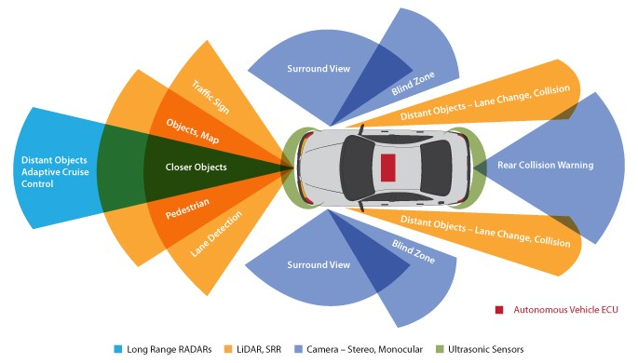
Sensor Fusion
Sensor fusion is the process of combining data from multiple sensors to improve the accuracy and reliability of measurements and provide a more complete understanding of the environment.

Slide 27
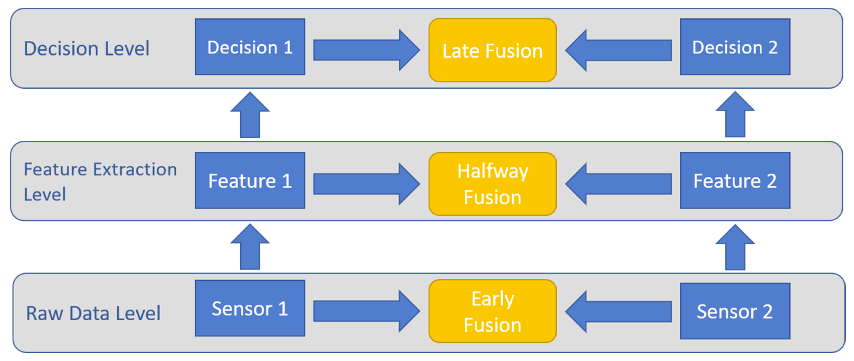
Techniques for Sensor Fusion

Slide 28
Techniques for Sensor Fusion
Data Fusion: It involves combining data from multiple sensors and filtering out irrelevant or redundant data to obtain a more accurate measurement.
This technique can be used to reduce noise and improve signal quality.
Feature Fusion: It involves combining features or characteristics extracted from sensor data to obtain a more complete representation of the environment.
This technique can be used to identify patterns and anomalies in data.
Decision Fusion: It involves combining multiple decisions or outputs from sensors to make a final decision.
This technique can be used to improve the reliability and accuracy of decisions.

Slide 29
Quiz

Slide 30
HAL: Do you read me?
2001: A Space Odyssey: A Conversation with HAL (1968)
An exciting vision of AI!
Speech,
Facial recognition,
Lip reading,
Systems monitoring,
Regulation and control,
Game play, and
Social skills

Slide 31
Activity
Group Formation and Discussion
How does HAL demonstrate intelligence in the movie clip?
What characteristics of intelligent systems are exhibited by HAL?
What knowledge representation techniques could be employed to create a system like HAL?
How might reasoning, logic, and inferences be utilized in building such a system?
What role could machine learning, natural language processing, and computer vision play in creating a system like HAL?

Slide 32
Activity
Scenario Introduction
Introduce a scenario: Designing a conversational AI system similar to HAL.
Example scenario: Creating an intelligent personal assistant for a futuristic smart home or a virtual customer service agent for a company.
Design and Planning Phase
Brainstorm and discuss your approach to designing the conversational AI system.
Consider aspects such as knowledge representation, reasoning, machine learning, natural language processing, and computer vision techniques.
Address the limitations of the HAL and the challenges faced by the human characters in the movie clip in their design.

Slide 33
In-Class Activity: SDG
Phase II: Group Brainstorming on Solutions (20 minutes):
Brainstorm and propose potential applications to address ONE specific challenge. Identify the performance metric!!!
Ensure that the proposed solutions align with the needs and context of the SDG.
Deliverable: A detailed proposal outlining the ubiquitous computing solutions for the assigned SDG challenge.
Phase III: Group Presentations and Discussion (10 minutes):
Prepare a presentation [3-5 slides] to showcase your proposed solutions.
Clearly explain how the solutions leverage ubiquitous computing to tackle the assigned SDG challenge effectively.
Discuss the potential impacts and benefits of implementing the proposed solutions.
Deliverable: Group presentation slides and active participation in the discussion.

